Slide 1

Decentralised IoT using

Slide 2
The current scenario:
The current IoT infrastructure relies on a centralized communication models that are also known as the server/client paradigm.
The connection of each device goes exclusively through the internet, even if they are a few feet apart.

Slide 3
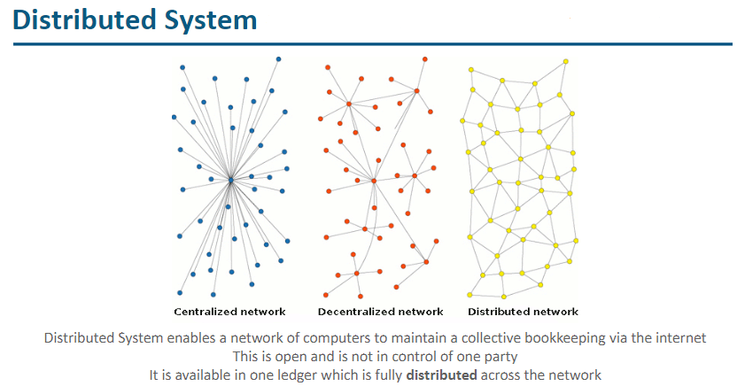

Slide 4
Problems:
The existing IoT solutions are expensive due to the high maintenance and infrastructure cost associated with the networking equipment, large server farms, and centralized clouds.
The cloud servers can be a point of failure that might disrupt the entire network
This is especially important for applications such as healthcare, or power distribution.

Slide 5
Solution:
Adopting a standardized peer-to-peer communication model to process the hundreds of billions of transactions between devices will significantly reduce the costs associated with installing and maintaining large centralized data centers and will distribute computation and storage needs across the billions of devices that form IoT networks.
This will prevent failure in any single node in a network from bringing the entire network to a halting collapse.

Slide 6
So why aren’t we using it?
One of the biggest challenges we face with a peer to peer network is with security. How do we secure the data on the network?
Another challenge that come with such networks is termed as a “cold start” problem.

Slide 7
A potential solution
As the ledger is tamper-proof, it cannot be manipulated by malicious actors as it does not exist in a central location.
Using blockchain technology in IoT, helps IoT networks deal with the issue of scale, thus allowing billions of networks to share the same network without the need to use additional resources.
Using blockchain would allow you to create an incentive system to reward builders in two ways: first, by providing wireless coverage the builder could earn mining rewards; and second any time an IoT device connects to a hotspot to transfer data to the internet the builder also earns.

Slide 8
What is

Slide 9

Bitcoin is a Cryptocurrency which was started in 2009
Blockchain is the underlying technology for Bitcoin

Slide 10
A blockchain, originally “block” “chain”, is a growing list of records, called blocks, which are linked or chained using cryptography.

Slide 11
The Blockchain is a decentralized ledger of all transactions across a peer-to-peer network. Using this technology, participants can perform transactions without the need for a central certifying authority. Potential applications include fund transfers, settling trades, voting and many other uses.

Slide 12
Key Features
Blockchain transactions are
•Immutable
•Secured
•Transparent
•Shared
Blockchain
•Avoids double spending
•Relative user anonymity

Slide 13
Key Technologies
•Cryptography (Hash function, Private/public key Pairs, Digital addresses)
•Electronic Wallets
•Distributed Network
•Peer-to-Peer Network
•Distributed Ledger Technology
•Mining
•Consensus Mechanism

Slide 14
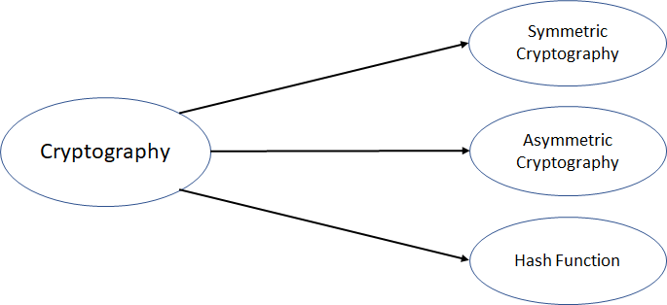
Cryptography
Cryptography is the science of encrypting and decrypting written communication. It comes from the Greek word “kryptos”, meaning hidden and “graphia” meaning writing.

Slide 15
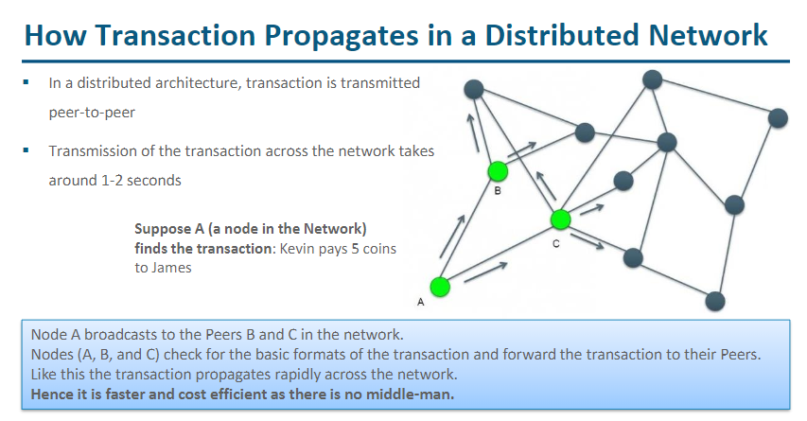

Slide 16

Ethereum
Ethereum is an open-source, public, blockchain-based distributed computing platform featuring smart contract (scripting) functionality.
Ethereum developers can code smart contracts on Ethereum, which serves as the blueprint for the Dapp.

Slide 17
